Slide 1
Neural Transformation Learning for Deep Anomaly Detection Beyond Images
Paper Presentation On
Course – Deep Learning with Medical Informatics (CS 895)
By – Monalika Padma Reddy

Slide 2
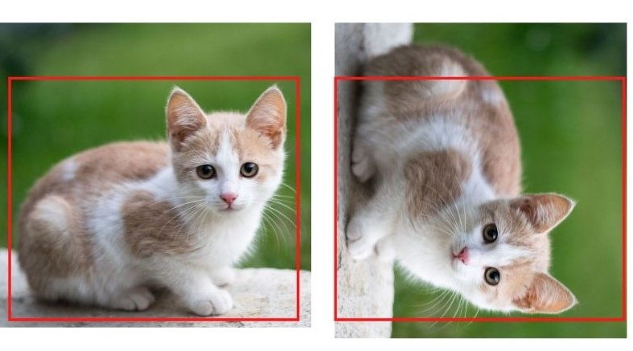
INTRODUCTION
Anomaly – Something that differs from a norm: a deviation, an exception that doesn’t fit into a pattern
Catching and identifying anomalies - Anomaly detection.
Many recent advances in anomaly detection rely on the paradigm of data augmentation
Image data - predefined transformations such as rotations, reflections, and cropping used to generate varying views of the data.
What are the suitable transformations for other kinds of data?
Example: Tabular Data, Time Series Data
Hard to design these transformations manually.
 | Value | Unit
Height | 180 | Cm
Weight | 67 | lbs
Value | Unit | Cm
 | 180 | lbs
Height | Weight | 67
Good transformations for images are known

Slide 3
APPROACH OF THE PAPER
Studies self-supervised anomaly detection for data types beyond images.
Develop Neural Transformation Learning For Anomaly Detection (NeuTraL AD)
Simple end-to-end procedure for anomaly detection with learnable transformations.
Derive a single objective function for jointly learning useful data transformations and anomaly thresholding
Aims to learn the transformations on time-series and tabular data
Deterministic Contrastive Loss (DCL) designed to learn transformations.
Using the learned transformation, detect/learn the abnormal time series on a whole Sequence level
Detects anomaly on real-world time series datasets like medical and cyber-security domains
Approach leads to a non-stochastic objective that neither needs any additional regularization or adversarial training and can be directly used as the anomaly score.

Slide 4
Neural Transformation Learning For Anomaly Detection (NeuTraL AD)

Slide 5
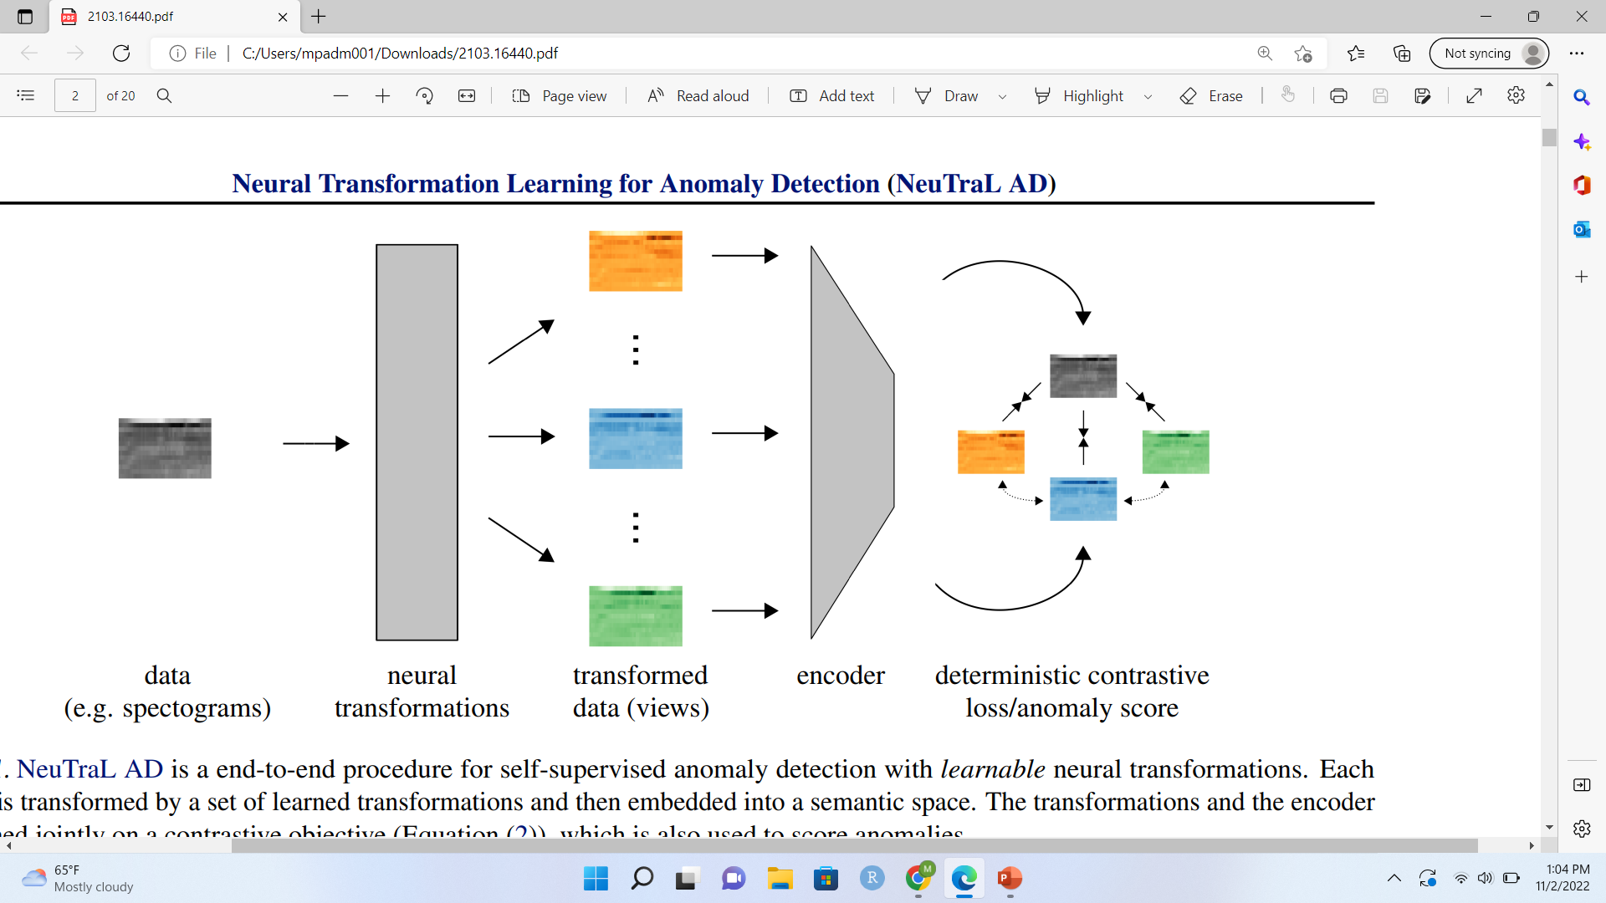
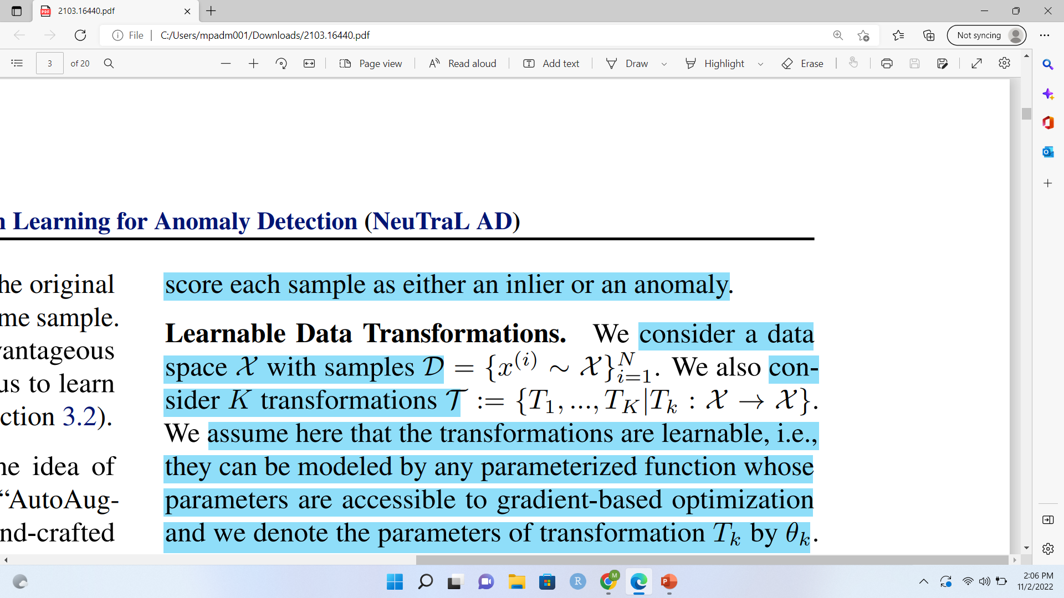
A simple pipeline with two components:
Set of learnable transformations – Neural Transformations
Encoder
Learnable transformations - Learns transformations of the data
Encoder – Extracts the representations of the transformed data
Each sample X, is transformed by a set of learnable transformations Tk.
The different views and the original data is mapped into the semantic space using the encoder
Neural Transformers and Encoders –
Neural networks and trained jointly and learn together with the DCL
Deterministic Contrastive Loss (DCL) –
During training, it is optimized to find the parameters of the encoder and the transformations
During testing, used to score each sample as either an inlier or an anomaly.
Learnable transformations –
Data space X with samples D is considered
K number of transformations T are also considered
Transformations T = T1, …, Tk is learned using the feed-forward neural network.
Assumptions - Transformations are learnable
i.e they can be modeled by any parameterized function whose parameters are accessible to gradient-based optimization

Slide 6
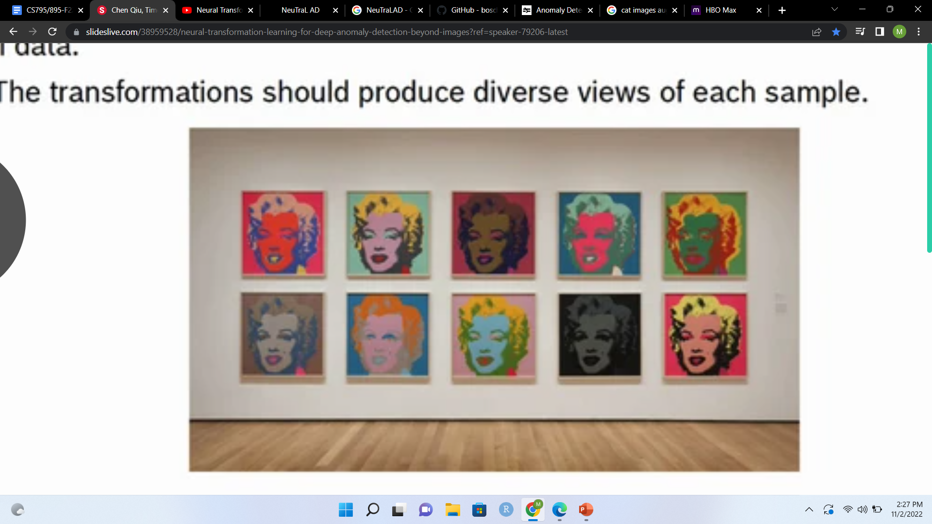
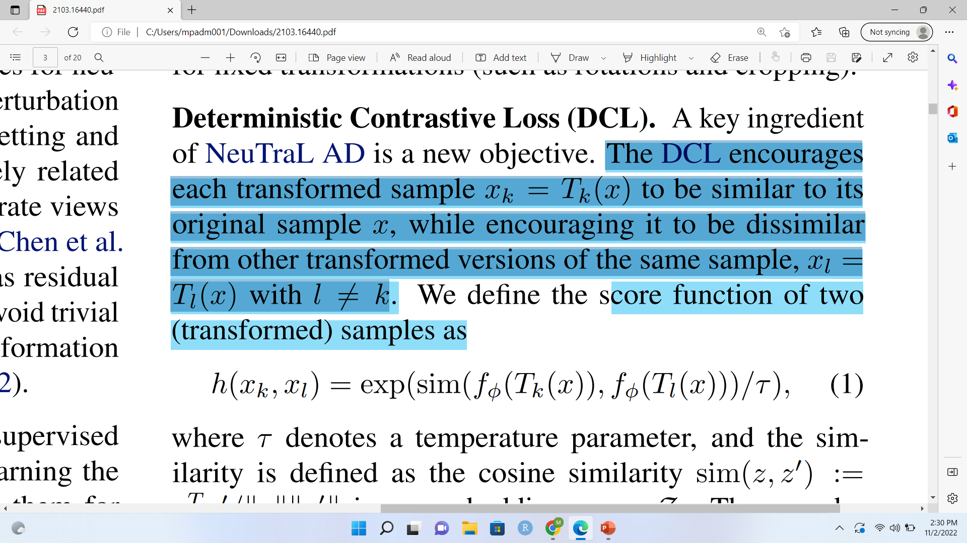
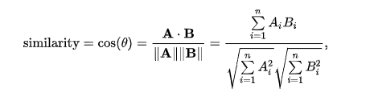
Deterministic Contrastive Loss (DCL)
Loss function proposed to learn the good transformations
Good Transformations –
Should produce different views that share relevant semantic information with the original data
Transformations should produce diverse views for each sample
Encourages each transformed sample to be similar its original sample x,
while encouraging it to be dissimilar from other transformed versions
of the same sample
Score function of two (transformed) samples –
Tk(x) - transformed the original data x using the transformations
Tl(x) - transformed the original data x using the transformations, but is different from Tk(x) in some aspects
sim(z, z’) – similarity that is defined using the cosine similarity
Cosine Similarity –
Measurement that quantifies the similarity between two or more vectors.
Cosine of the angle between vectors.
Mathematical description - Ratio of the dot product of vectors and the product of the euclidean norms or magnitude of each vector.
τ – Temperature Parameter
fφ(·) – Encoder that acts like a feature extractor

Slide 7
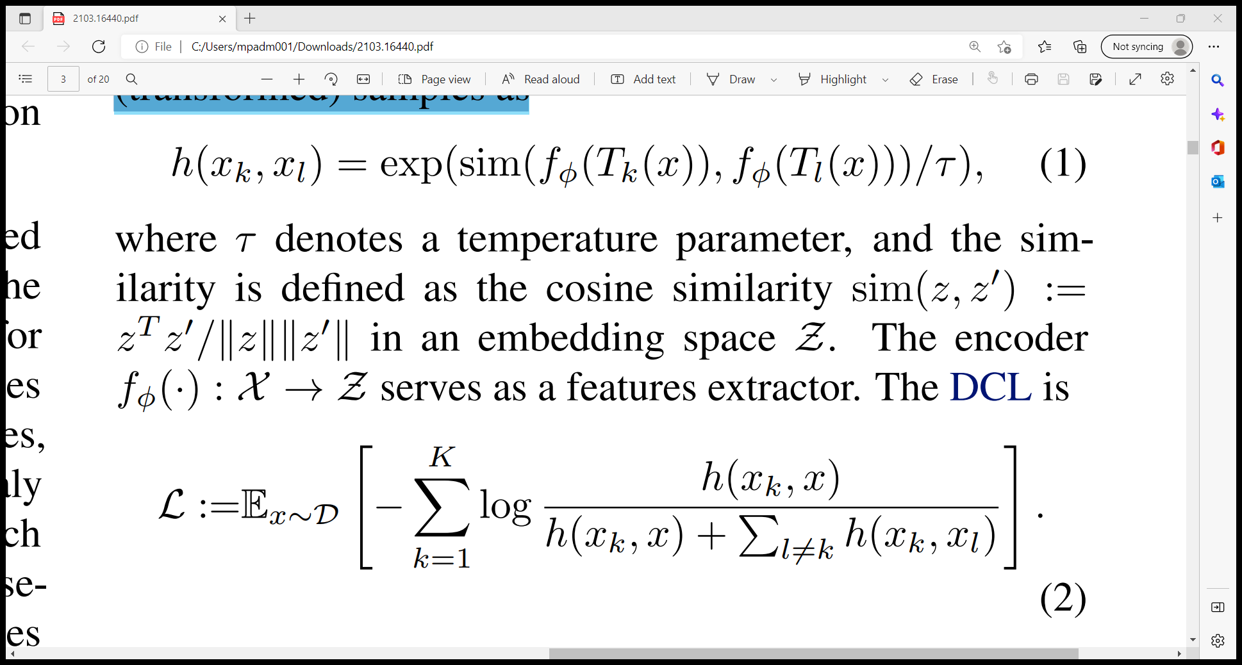
Pulls the embedding of each transformed sample close to the embedding of the original sample. This encourages the transformations to preserve relevant semantic information.
Anomaly Score
Pushes all the embeddings of the transformed samples away from each other, thereby encouraging diverse transformation
One advantage of the proposed approach over other methods
The training loss is also the anomaly score.
Since the score is deterministic, it can be straightforwardly evaluated for new data points without negative samples
Negative samples are not drawn from a noise distribution, but constructed deterministically from sample X
The higher the anomaly score, the more likely that a sample is an anomaly
Extremely simple
Does not need any additional regularization

Slide 8

IMPLEMENTATION DETAILS
Parametrizations of the learnable transformations:
feed forward Tk(x) := Mk(x)
residual Tk(x) := Mk(x) + x
multiplicative Tk(x) := Mk(x) x which differ in how they combine the learnable masks Mk(·) with the data
Neural Transformations (Masks Mk) –
Consist of one convolutional layer on the bottom, a stack of three residual blocks of 1d convolutional layers with instance normalization layers and ReLU activations, as well as one convolutional layer on the top.
Convolutional layers - kernel size = 3, stride = 1
Dimension of the residual blocks is the data dimension.
Convolutional layer on the top has an output dimension as the data dimension.
For the multiplicative parameterization, a sigmoid activation is added to the end.
All bias terms are fixed as zero
Learnable affine parameters of the instance normalization layers are frozen
Encoder –
a stack of residual blocks of 1d convolutional layers with ReLu activations and one 1d convolution layer on to of all the residual blocks.
Number of blocks depends on the dimensionality of the data

Slide 9
EVALUATION PROTOCOL
One-vs-rest
Dataset is split by the N class labels, creating N one class classification tasks;
Models - trained on data from one class and tested on a test set with examples from all classes.
The samples from other classes should be detected as anomalies
n-vs-rest
n classes (for 1 < n < N) are treated as normal
Remaining classes provide the anomalies in the test and validation set.
By increasing the variability of what is considered normal data, one-class classification becomes more challenging.

Slide 10
RESULTS
Aim - to detect abnormal time series on a whole sequence level
Datasets -
Time Series Datasets
SAD
NATOPS
Character Trajectories
Epilepsy
Racket Sports
Tabular Datasets
Small-scale medical datasets
Arrhythmia and Thyroid
Large scale cyber intrusion detection datasets
KDD and KDD

Slide 11
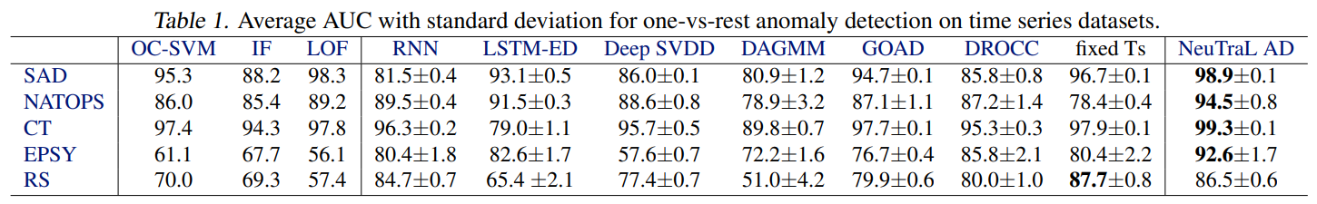
Anomaly Detection of Time Series
Only on the RS data, it is outperformed by transformation prediction with fixed transformations
Designed to understand the value of learning transformations with NeuTraL AD vs using hand-crafted transformations.
Results confirm that designing the transformations only succeeds sometimes, whereas with NeuTraL AD the appropriate transformations can be learnt.
The learned transformations also give NeuTraL AD a competitive advantage

Slide 12
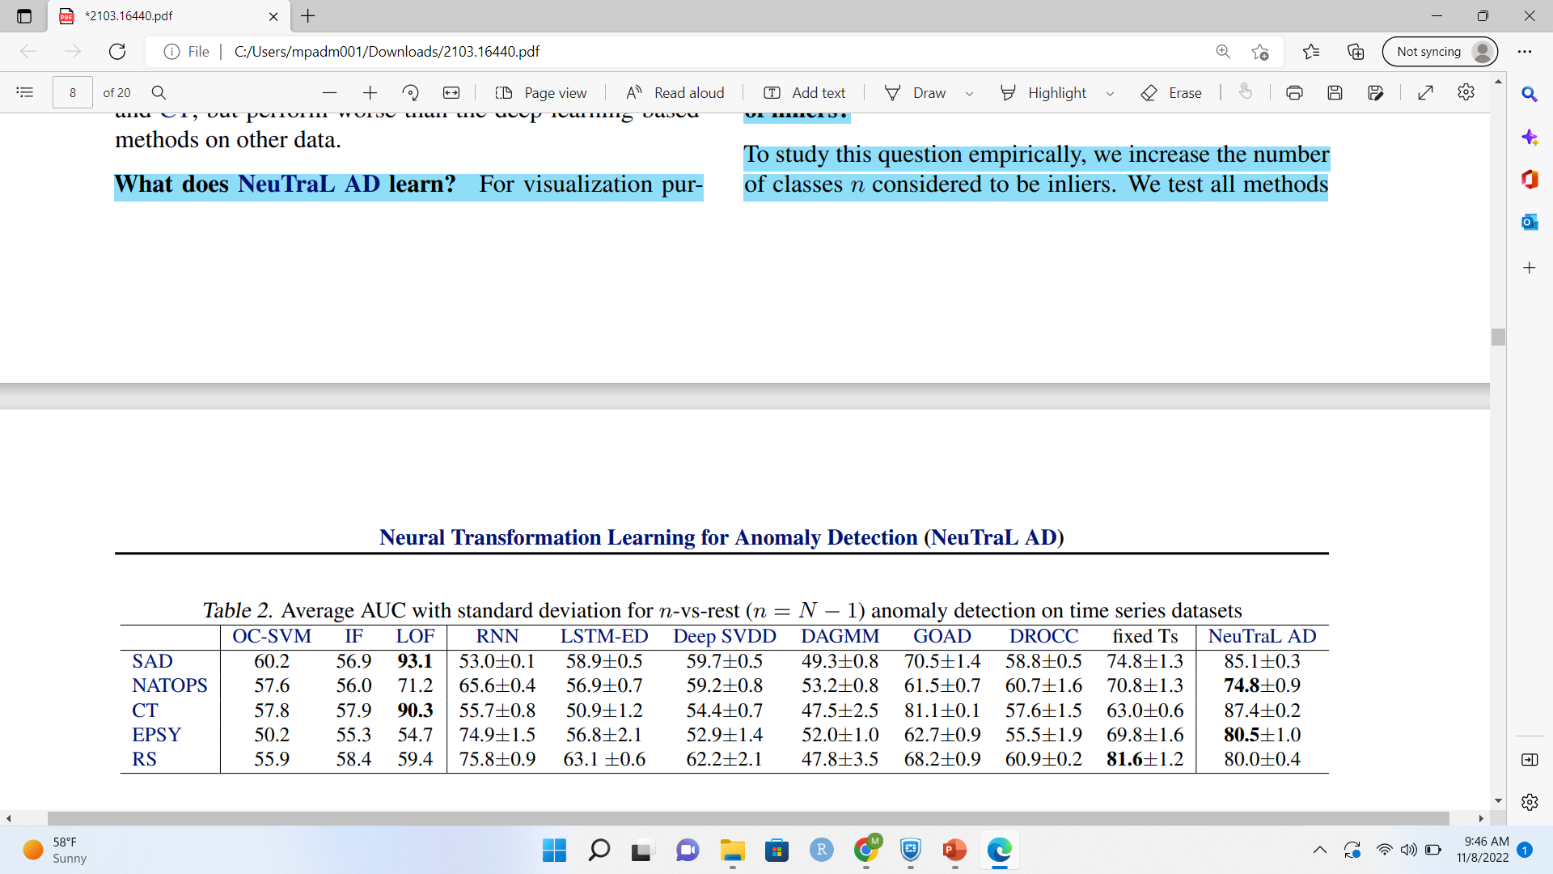
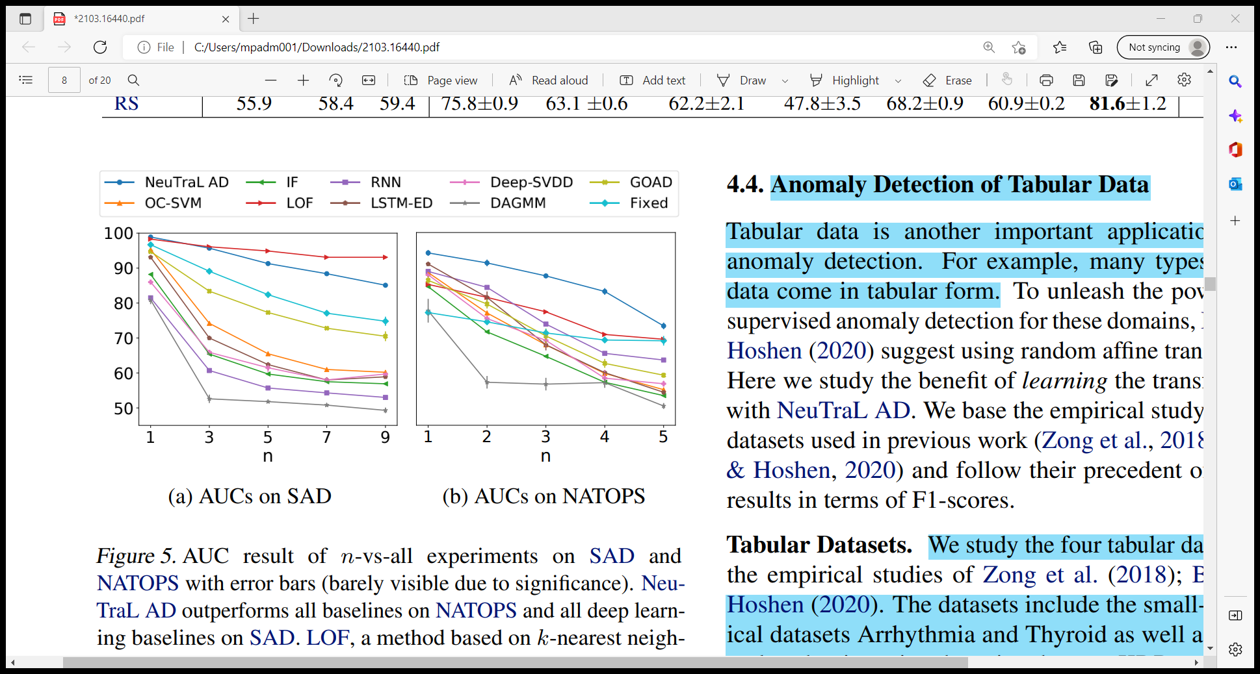
How do the methods cope with an increased variability of inliers?
To study this question empirically, the number of classes n considered to be inliers are increased.
Test all methods on SAD and NATOPS under the n-vs-rest setting with varying n.
Since there are too many combinations of normal classes when n approaches N − 1, only consider combinations of n consecutive classes.
Quantitative results for n = N − 1 under the n-vs-rest setting for all time series datasets, where only one class is considered abnormal, and the remaining N − 1 classes are normal. Performance of all deep learning-based methods drops as the variability of normal data increases. NeuTraLAD outperforms other deep learning methods on 4 out of 5 datasets. On RS, it is outperformed by transformation prediction with hand-crafted transformations
Performance of all methods drops as the number of classes included in the normal data increases. This shows that the increased variance in the nominal data makes the task more challenging. NeuTraL AD outperforms all baselines on NATOPS and all deep-learning baselines on SAD.

Slide 13
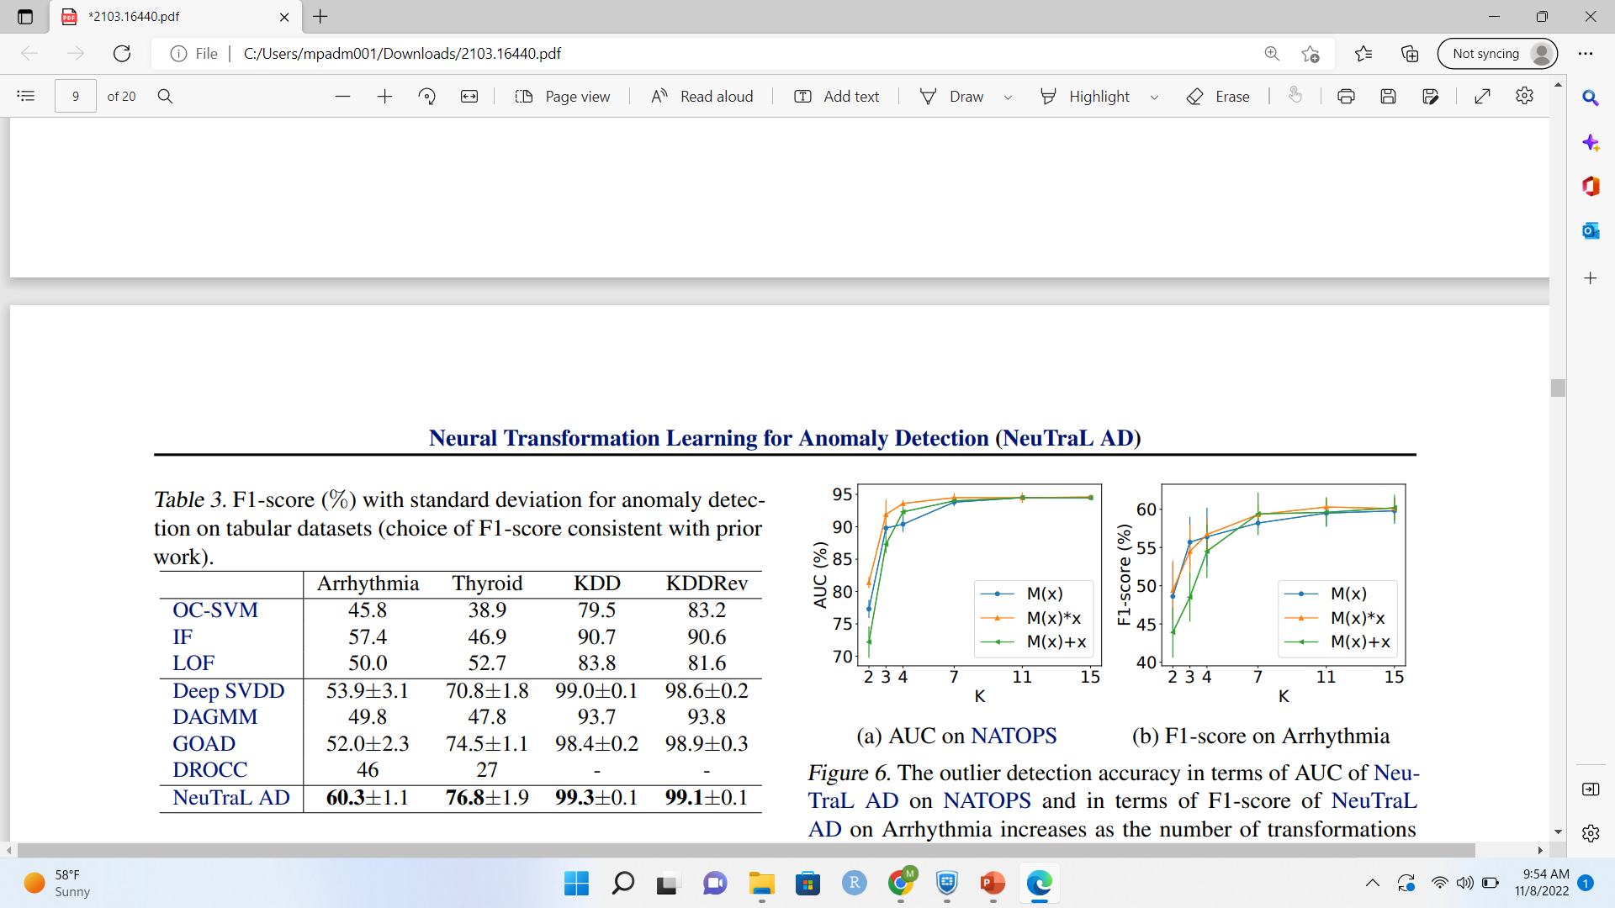
Anomaly Detection of Tabular Dataset
F1-score (%) with standard deviation for anomaly detection on tabular datasets (choice of F1-score consistent with prior work).

